Slide 1

Oracle Architecture
Group based Project

Slide 2
Group1 Usman Javaid (BCSF18M008)
Muhammad Anas (BCSF18M028) Group Leader
Zohaib Riaz (BCSF18M037)
Nouman Rehman (BCSF18M027)

Slide 3
Oracle & Oracle Server
Oracle is a relational database management system.
In general, a server reliably manages a large amount of data in a multiuser environment so that many users can concurrently access the same data.
A database server also prevents unauthorized access and provides efficient solutions for failure recovery.

Slide 4
Oracle Server consists of :
Oracle data base
Oracle Instance

Slide 5
Oracle Database
An Oracle database is a collection of data treated as a unit. The purpose of a database is to store and retrieve related information.
A database server is the key to solving the problems of information management.
In general, a server reliably manages a large amount of data in a multiuser environment so that many users can concurrently access the same data.

Slide 6
Oracle data base consists of Software Modules and Data base files. All of them are categorized in two structures:
Logical Data base Structure
Physical Data base Structure

Slide 7
1) Oracle Logical data base structure
The logical structures of an Oracle database include:
Data blocks
Extents
Segments
Tablespaces
Schema objects

Slide 8
Data Blocks
At the finest level of granularity, Oracle database data is stored in data blocks.
One data block corresponds to a specific number of bytes of physical database space on disk. The data block size can be set for each Oracle database when it is created.
This data block size should be a multiple of the operating system’s block size.

Slide 9
Data Block Components
A data block has the following structure:
• Header: contains general information such as block address and type of segment.
• Table directory: contains information about the tables that have data in the data block.
• Row directory: contains information about the rows in the data block.
• Row data: contains the actual rows of table data. A row can span blocks.
• Free space: allocated for the insertion of new rows and updates to rows that require additional space. As of Oracle8i, Oracle can manage free space automatically

Slide 10
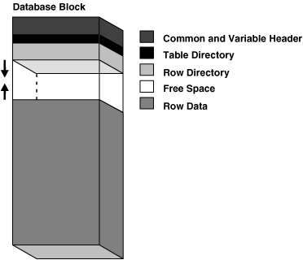
Structure of a Data Block

Slide 11
Extents
The next level of logical database space is an extent.
An extent is a specific number of contiguous data blocks, obtained in a single allocation.
They used to store a specific type of information.

Slide 12
Segments
Above extents, the level of logical database storage is a segment.
A segment is a set of extents allocated for a certain logical structure.
It has four types, including data segment, index segment, temporary segment, rollback segment.

Slide 13
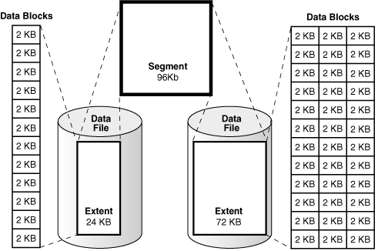
Connection among Extents, Data Blocks and Segments
Is illustrated in this very diagram:

Slide 14
TableSpaces
An Oracle database is divided into logical storage units called tablespaces.
A tablespace is used to group related logical structures together.
For example, tablespaces commonly group all the application’s objects to simplify some administrative operations.
Every Oracle database contains a tablespace named SYSTEM, which is created automatically when the database is created.

Slide 15
Schema
A schema is a collection of database objects.
A schema is owned by a database user and has the same name as that user. Schema objects are the logical structures that directly refer to the database's data.
Schema objects include structures like tables, views, and indexes, associated with a particular user. Where A user (sometimes called a username) is a name defined in the database that can connect to, and access, objects (schemas).

Slide 16
Schemas Objects
i) Tables: These are the basic unit of data storage in an Oracle database. Database tables hold all user-accessible data. Each table has columns and rows. Oracle stores each row of a database table containing data for less than 256 columns as one or more row pieces.
ii) Views: Views are customized presentations of data in one or more tables or other views. A view can also be considered a stored query. Views do not actually contain data. Rather, they derive their data from the tables on which they are based, referred to as the base tables of the views. Like tables, views can be queried, updated, inserted into, and deleted.
iii) Indexes: Indexes are optional structures associated with tables. Indexes can be created to increase the performance of data retrieval. Just as the index in this manual helps you quickly locate specific information; an Oracle index provides an access path to table data.

Slide 17
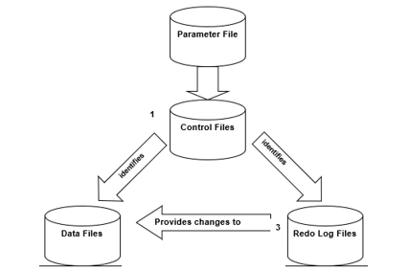
Physical Data Base Structure
There are three basic files system in Physical Data base structure, includes:
Datafiles
Redo log files
Control files

Slide 18
1) Data Files
Every Oracle database has one or more physical datafiles.
The datafiles contain all the database data. The data of logical database structures, such as tables and indexes, is physically stored in the datafiles allocated for a database.
Characteristics:
A datafile can be associated with only one database.
Datafiles can have certain characteristics set to let them automatically extend when the database runs out of space.
One or more datafiles form a logical unit of database storage called a tablespace.

Slide 19
2) Redo log File
Every Oracle database has a set of two or more redo log files. The set of redo log files is collectively known as the redo log for the database. A redo log is made up of redo entries (also called redo records).
Function: The primary function of the redo log is to record all changes made to data. If a failure prevents modified data from being permanently written to the datafiles, then the changes can be obtained from the redo log, so work is never lost.
Rolling forward: The process of applying the redo log during a recovery operation is called rolling forward.

Slide 20
Oracle Instance
A database instance is a set of memory structures that manage database files.
An Oracle instance contains the set of Database background processes that operate on the stored data
and the shared allocated memory that those processes use to do their work.
SGA consists of two components
System global area (SGA)
Background Processes

Slide 21
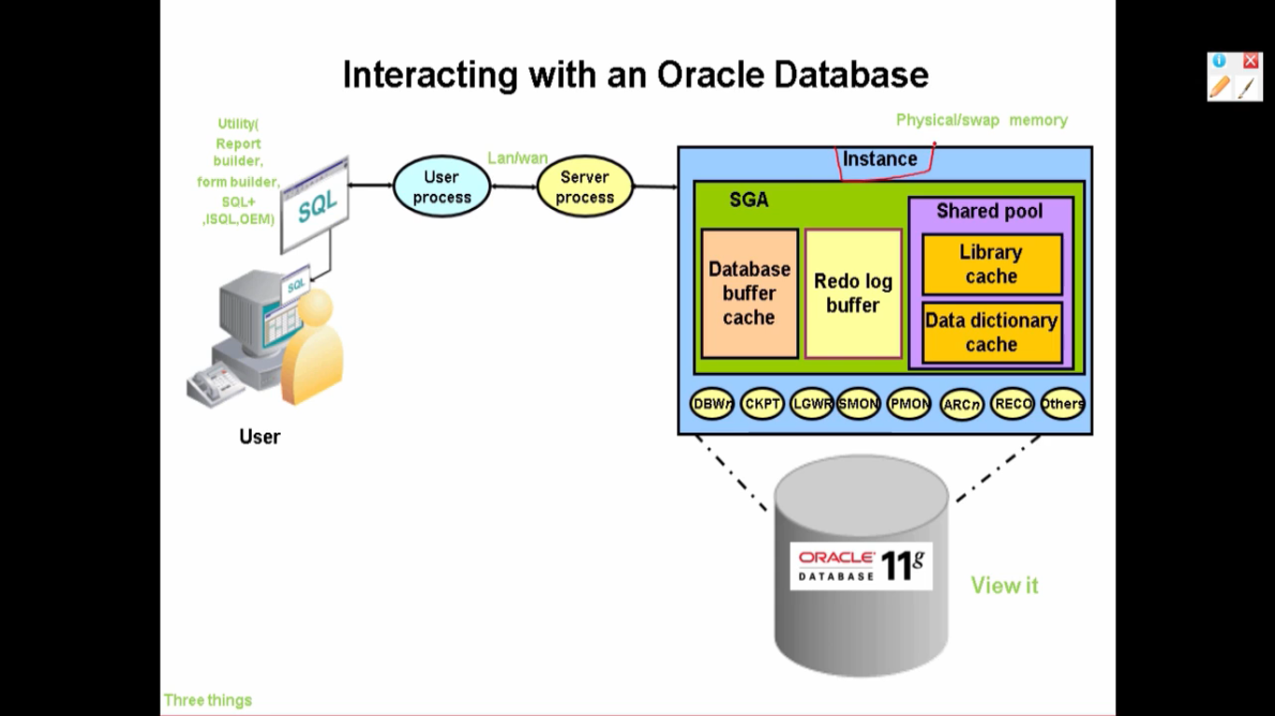

Slide 22
1) System Global Area (SGA)
The System Global Area (SGA) is a shared memory region that that contain data and control information for one Oracle Database instance.
The SGA is shared by all server and background processes
Each instance has its own SGA.
The information stored in the SGA is divided into several types of memory structures, including Data Base Buffer, Redo Logo Buffer, Shared Pool, Large pool in SGA, JAVA pools, Streams Pool, Fixed SGA.

Slide 23
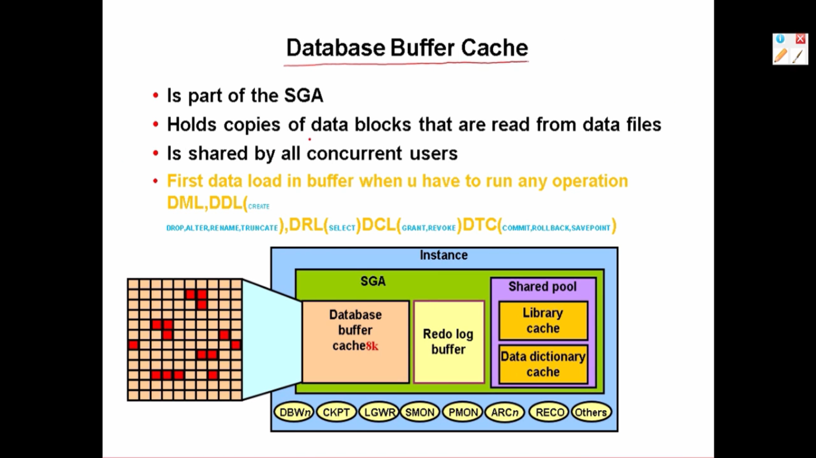

Slide 24
SGA components:
Data Base Buffer: database buffer cache is typically the largest portion of the SGA. It has data that comes from the files on disk. Because accessing data from disk is slower than from memory, It’s sole purpose is to cache the data in memory for quicker access.
Redo log buffer: It holds information about changes made to the database. This information is stored in redo entries. Redo entries contain the information necessary to reconstruct, or redo, changes made to the database by INSERT, UPDATE, DELETE, CREATE, ALTER, or DROP operations.
Shared pool: The shared pool area includes two main structures: The library cache, which stores parsed SQL and PL/SQL statements. The dictionary cache, which stores the Oracle data dictionary (or Oracle metadata)
Large Pool in the SGA: The large pool is an optional area that provides large memory allocations for Oracle backup and restore operations.

Slide 25
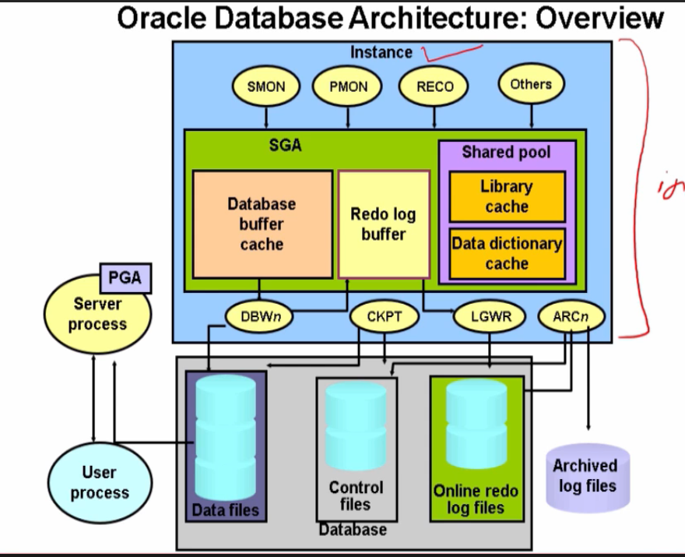

Slide 26
Processes
A) User processes: Oracle create user processes to manage communication with the server process through the program interface. The user process manipulates the user’s input, communicates with the Oracle server process, displays the information requested by the user and, if required, processes this information into a more useful form.
B) Server processes: Oracle creates server processes to handle requests from connected user processes. A server process communicates with the user process and interacts with Oracle Instance to carry out requests from the associated user process.

Slide 28
Background processes: Database background processes operate on the stored data. Each Oracle instance can use several background processes, which are as follows:
Database Writer (DBWn): The database writer writes modified blocks from the database buffer cache to the data files.
Log Writer (LGWR): The log writer writes redo log log buffer to a redo log file on disk
Checkpoint (CKPT ): Make synchronization between data files and redo log files i.e. update checkpoint information in both files.
System Monitor (SMON): The system monitor performs recovery at instance startup. It can perform instance recovery for other instances that have failed by and freeing resources that the instance was using. .
Process Monitor (PMON): Monitor all processes whether they all working fine. It performs process recovery when a user process fails. PMON is responsible for cleaning up the cache and freeing resources that the process was using.

Slide 29
Recoverer (RECO): The recoverer process is used to resolve distributed transactions that are pending due to a network or system failure in a distributed database.

Slide 31


